Slide 1
Secure data hiding in images using Steganography
CAPSTONE PROJECT
Presented By: Namitha Hegde
Student Name : Namitha Hegde
College Name & Department : CHRIST (Deemed to be University), Bengaluru – 560029
MSc. Forensic Science (Department of Life science)

Slide 2
OUTLINE
Problem Statement
Technology used
Wow factor
End users
Result
Conclusion
Git-hub Link
Future scope

Slide 3
Problem Statement
The rapid expansion of Digital communication is raising critical concerns in cyber threats and data security. Although the traditional encryption methods are effective, they are complex and can be detected as encrypted files, making them the target for decryption attempts. This project aims to introduce an image- based steganography tool using the Least Significant Bit (LSB) method to encrypt and decrypt messages with password protection.

Slide 4
Technology used
Programming Language
Python – Used to build encryption and decryption script
Libraries
OpenCV – A computer vision library to handle image processing and modification
Os – File handling
Numpy – Numerical computing library to support array based operations for data embedding
Least Significant Bit (LSB) Steganography – Modifying LSB of pixel values in image to ensure minimal visual distortion
Password Based Authentication – User defined password to enhance security and prevent unauthorized retrieval
Platform used – Windows with Python installed

Slide 5
Wow factors
What makes this project stand out?
Dual Security Layer – The message is hidden inside an image making it invisible while data sharing causing 1st layer of security and the password based authentication to enhance security and prevent unauthorized retrieval.
User friendly Approach – The process is simple and do not require deep technical knowledge.
Lossless embedding – The quality of the image remains unchanged visually.
No additional storage required – Since the message is embedded inside the image, there is no requirement of additional storage or external files.

Slide 6
End users
Forensic Investigators – Hiding sensitive case-related messages while data sharing.
Journalists– Securely communicating sensitive information without detection.
Researchers – Learning and experimenting with data hiding techniques.
Military & Intelligence Agencies – Covert communication in high-security environments.
General Users – Sending hidden messages securely over images.

Slide 7
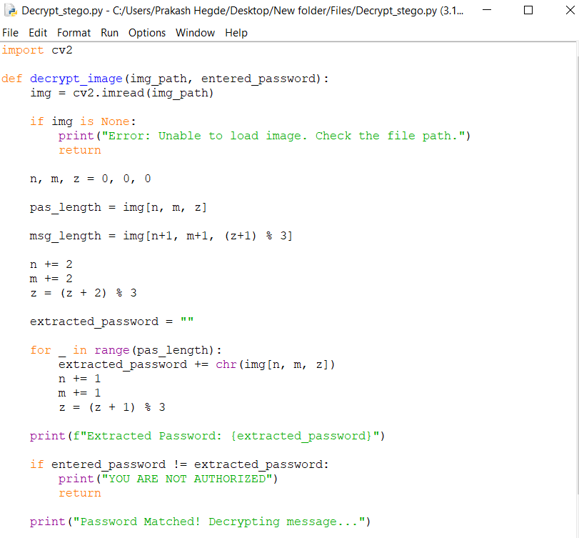
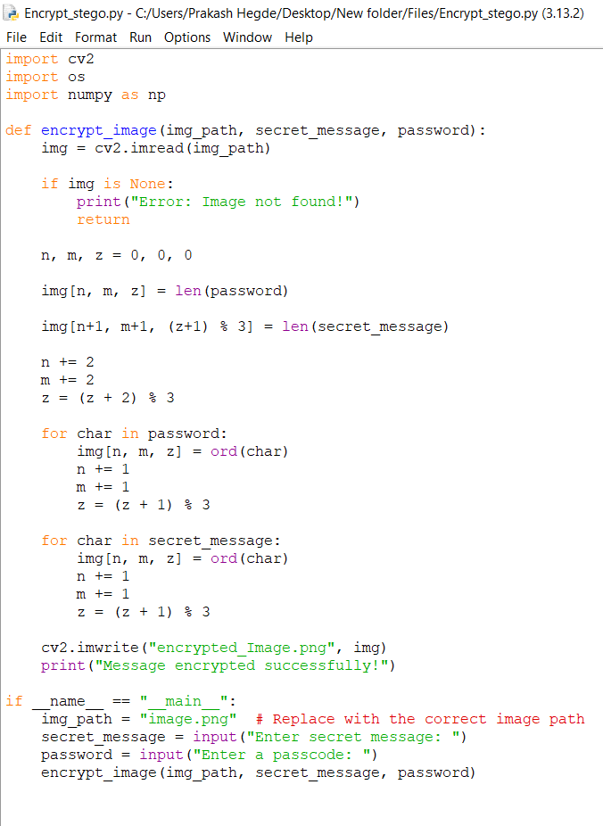
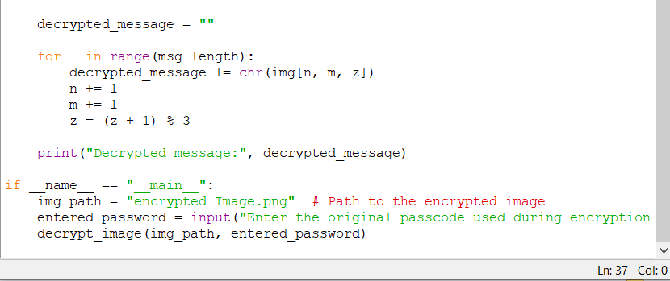
Results
Fig.1: Encryption code
Fig.2: Decryption code

Slide 8
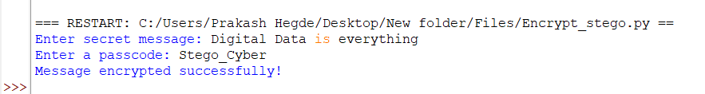
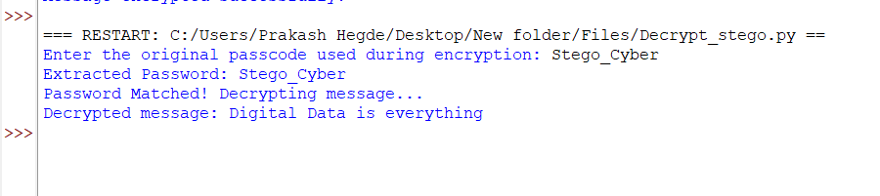
Fig.3: Encryption Output
Fig.2: Decryption Output

Slide 9

Fig.5: Encrypted Image

Slide 10
Conclusion
This project demonstrates how LSB-based steganography can be effectively used for covert communication.
By implementing password-based access control, we enhance security, making it more difficult for unauthorized users to extract the message.
This approach provides a simple, efficient, and secure way to transmit sensitive information without raising suspicion.
The use of LSB-based steganography enables the embedding the message without change in visual image quality.

Slide 11
GitHub Link
https://github.com/Hegdenamitha/Cyber-Project.git

Slide 12
Future scope(optional)
Support for multiple File Formats – Extend steganography method to audio, video, and text files alongside image formats like JPG, TIFF
Enhanced Security – Implement advanced encryption like ASE or RSA alongside steganography for double protection
Mobile Application – Develop a mobile-friendly version for easier and wider access.
AI-Powered Image Security – Use of deep learning or AI to image tampering and enhance the security.

Slide 13
THANK YOU

